Slide 1
CS0007
Week 6
1) Attendance

Slide 2
Project 2
Due Thursday, March 17th at 5pm
By the end, you should submit 9 files ( .java and .class files for activities 1, 3, 4, and 5)
ACTIVITY 2 IS SPECIAL: Create a flowchart (more details later) using Word or by hand-writing it and taking a picture of it; file must either be a .docx or a .jpg

Slide 3
Project 2 important details
This is NOT a GUI program. You should only use the console for input/output.

Slide 4
Activity 1
Just like the last project!
Use Scanner, along with the next() method to read in the user’s name and modify the welcome message accordingly! Try to describe your project as detailed as possible.

Slide 5
Activity 1 (cont.)
1) Say hello, display your welcome message, and write a brief description of what your program will do
2) Include instructions for your game (Rockymon). This might require you to read several of the activities to gain a sense of direction.
3) DO NOT FORGOT TO COMMENT ALL OF YOUR VARIABLES AND METHODS!

Slide 6
Activity 2
Creating a flowchart
Can be created using Word or by drawing it on a piece of paper and uploading the file to CourseWeb.
The file must be a .docx or a .jpg
There is a flowchart cheatsheet on CourseWeb
(under the Week 1 link)

Slide 7
Activity 2 (cont.)
The flowchart should depict an entire working game (use Activity 4 as a reference to what it should function like)
When creating the flowchart, think business managerial oriented instead of programming oriented (don’t say askForName(), instead convert it to English, “Ask for user’s name”)

Slide 8
Flowcharts (all of these nodes are required) (all the colors are optional)
Everything should be linear (move from Start to Finish)
Start and End with terminator nodes
Process node perform processes
Decision nodes are true if the question is true and false if
the question is false; just makes a decision
Decision nodes only have two nodes coming out of them (Yes or No)
Start
End
Roll the dice
Did the player win?

Slide 9
Flowcharts (cont.) all of these nodes are required
Ask for user’s name
Manual Input Nodes take in user input
Flows/Arrows connect nodes together and directs the reader to the next step in the program

Slide 10
Flowcharts (this node is optional)
On/Off Page References direct the reader to another point in the flowchart if you run out of space while drawing it
Off-page On-page
Page 2
A

Slide 11
Example Flowchart
The lamp won’t turn on
A
Is the lamp plugged in?
Is the bulb burned out?
No
Plug the lamp in
Replace the bulb
Yes
Yes
Give up and buy a new lamp
A

Slide 12
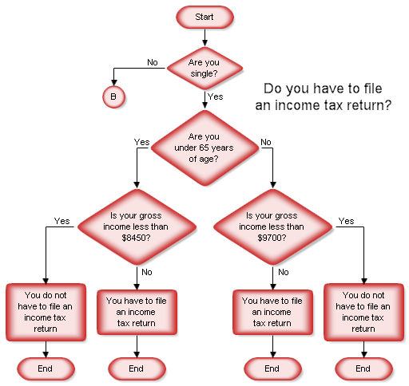
More complex flowchart

Slide 13
Even more complex flowchart!
http://radiantorganizing.com/wp-content/uploads/2012/11/The-Procrastination-Flowchart.jpg

Slide 14
Additional Project 2 Requirements
Only for people working ahead: If you get to Activity 4, do not copy
and paste the code from Activity 3 into a for loop! Karen does not
want you to print out every dice roll for every single round when the
computer is simulating the game. Rather, print out number of wins
and losses OR just “You won game X” every time the computer
simulates a winning around.

Slide 15
NEXT WEEK IS YOUR MIDTERM
Attendance for recitation is optional
For review, go to the Discussion Board on CourseWeb and follow the steps.
Don’t forget to put your last name in the thread of the discussion board!

